Slide 1
mondego.ics.uci.edu/projects/dejavu
DéjàVu A Map of Code Duplicates on GitHub
UC Irvine : Crista Lopes, Pedro Martins, Vaibhav Saini, Di Yang, Hitesh Sajnani
CTU Prague : Petr Maj, Jakub Zitny
Northeastern : Jan Vitek
Notes:
Good morning/afternoon, welcome to our talk “Dejavu – A Map of Code Duplicates on Github”.
We are originally PL people and our ultimate goal is to analyze interesting properties of large code repositories. But to do so, one has to first build the infrastructure and understand the most basic properties of the data to prevent biases.
A good way to do this is to find a simple question about your data and answer it.

Slide 2
How many duplicates are there on GitHub? (motivation: avoid selection bias in further studies)
Notes:
We have chosen to investigate how many duplication is there on github, because answering this will allow us to mitigate the selection bias on our further studies.
Answering this is really useful because it allows us to at least understand, or even remove the selection bias from our studies.

Slide 3
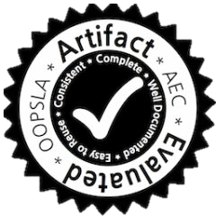
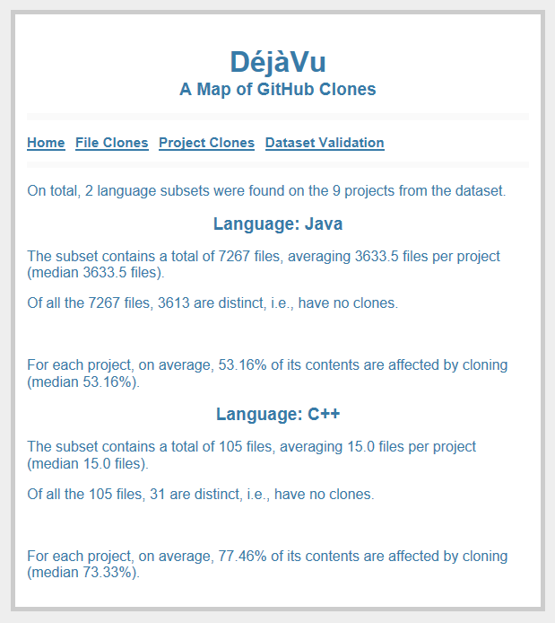
What can we do for you?
Notes:
We believe that removing selection bias is really important. To that end our paper is accompanied with an artifact that makes two things really easy:
For any further studies, you can use our webservice to obtain an assessment of code duplication in the projects or files from github you want to analyze
Our entire pipeline is fully automated and is super easy to be adapted to different languages or even different data sources.
While the paper and the artifact describe these in great detail, in this presentation I am going to briefly explain what we did and then focus on some of the discoveries have made while working on our paper.

Slide 4
Projects
JavaScript
Java
1.8 M
1.5 M
C/C++
363 K
Python
893 K
Notes:
For four popular languages, we have downloaded all of their non-forked repositories on GitHub.
In terms of projects, this amounted to:
one and point eight million projects for JavaScript, followed by
one and half million projects for Java
eight hundred ninety thousand projects for Python
and finally only three hundred sixty thousand projects for the C and C++ languages which we grouped together.

Slide 5
Files
JavaScript
Java
262 M
73 M
C/C++
62 M
( projects)
Python
33 M
Notes:
The inner circle still shows the proportion of downloaded projects so that they can be judged against the outer circle, which represents the amount of downloaded files for the our four languages.
JavaScript had by far the largest amount, a total of two hundred sixty two millions, which is more than the three other languages combined
JavaScript was followed by distance by Java, C/C++ and Python with
Now that we have the dataset, what would it take to find out all pairs of similar files?

Slide 6
262,000,000
Notes:
JavaScrpt was the largest, with 262 million files.

Slide 7
68,644,000,000,000,000
Notes:
Checking for duplication would naively require this many comparisons.
English is not my first language, so I am not even going to try to read it.

Slide 8
10 ms
Notes:
If each comparison would only take 10ms

Slide 9
21,766,869 years
Notes:
We would need almost 22 million years to finish
Fortunately, there are ways to do better than this.

Slide 10
void : 1
foobar : 1
int : 3
foo : 3
bar : 3
baz : 3
if : 1
42 : 1
return : 2
else : 1
FILE 1
double : 3
16 : 1
hello : 3
for : 1
x : 7
y : 3
FILE 4
for : 1
while : 1
xy : 3
78 : 3
89 : 3
1 : 1
3 : 1
1, 3
2, 5
FILE 2
void : 1
foobar : 1
int : 2
double : 1
foo : 3
bar : 3
baz : 3
if : 1
43 : 1
return : 2
else : 1
double : 3
for : 2
while : 1
xy : 3
78 : 3
89 : 3
1 : 1
3 : 1
SourcererCC
FILE 3
FILE 5
mondego.ics.uci.edu/projects/SourcererCC
Notes:
For each file we see, we first take a hash to determine very quickly if two files are identical.
We then tokenize the file, a process in which we remove any comments, whitespace and separators (operators, etc.), and count the occurrences of the remaining tokens.
These tokenized files are then fed into SourcererCC, a scalable clone detector which produces a list of pairs of files that are similar to each other (over 80% similarity in tokens).
SourcererCC employs clever techniques to find and quickly compare only files that can be similar and so it took only a few days to compute similar files in the 262 millions of JavaScript files.

Slide 11
9 months later
Notes:
But…
We have totally underestimated the infrastructure part of such a large code analysis. It took us a lot of time to build the tools to download, filter & analyze the data, and even more so to build confidence into our results.
So without further ado…

Slide 12
File-Level Duplication
79%
MD5 identical
Notes:
In terms of all languages combined,
we have found that almost 80% of are identical copies of the remaining twenty one percent – this means their file hash is identical.

Slide 13
9%
SCC similar
79%
MD5 identical
Notes:
A further 9% of total files was reported by SourcererCC to be nearly identical to the remaining…

Slide 14
12%
original
9%
SCC similar
79%
MD5 identical
Notes:
twelve percent of original files.

Slide 15
original
13%
similar
identical
Java
30%
C/C++
19%
3%
Python
JavaScript
Notes:
When we look at the copying rates for the respective languages,
Java and JavaScript are the clear outliers with Java having 30% original files and less than half of the dataset being identical copies
JavaScript on the other hand has only 3% of original files and a staggering total of 94% of its files are identical copies
C and Python somewhat in the middle with 13% of original files for C and 19% for Python.
So far, we have included all files in our analysis, including trivial files, such as the empty file, which in fact for all four languages was the single most widely copied one.
To make sure our results are not skewed by these very small files, we decided to exclude any files with less than 50 tokens.

Slide 16
original
similar
identical
Java
C/C++
w/o small files
( entire dataset)
Python
JavaScript
Notes:
While the inner circle displays the results for entire datasets for comparison, the outer circles display the results when these small files are excluded.
While the dataset has shrunk significantly (from 80% of the original for C to only 62% of the original dataset in JavaScript)
We found that the proportions of clones are almost the same, suggesting that rampant copying is prevalent even for larger files.
In the next set of slides, we are going to briefly examine the different levels of similarity reported in these graphs for each language, starting with Java.

Slide 17
identical
similar
original
Java
Notes:
For all languages, most frequently duplicated non-trivial files were parts of popular frameworks, specifically in Java, these were:
Action Bar Sherlock (same Action Bar API on different Android versions)
Cordova (mobile application framework)
okhttp (mobile http client)
For each language we have also looked at the similar files, randomly picking 20 pairs and classified them into three categories:
Intentional (copy a file then edit it)
Unintentional (accidental clones, such as different versions of a library, etc.)
Autogenerated (automatically generated files that are inputs to other tools)

Slide 18
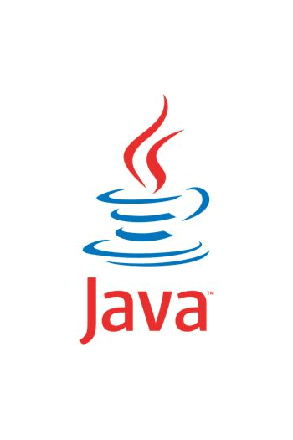
identical
similar
original
Java
2/20
6/20
unintentional
intentional
autogenerated
12/20
Notes:
For Java, 60% of the analyzed pair were autogenerated configuration and setup files for:
Apache axis (web service framework, SOAP server)
Android
Java Architecture for XML Binding
We have found 2 instances of unintentional cloning:
boilerplate code for android applications
Finally, 30% of the pairs were classified as intentional:
Inter-project copies when similar functionality was required in multiple contents
Intra-project clones we have observed were from school assignments

Slide 19
C/C++
identical
similar
original
Notes:
In C/C++, mostly cloned files came from the boost libraries and the free type project.

Slide 20
identical
similar
original
12/20
intentional
5/20
unintentional
3/20
autogenerated
Notes:
Unlike Java, C++ was dominated by intentional clones (60%)
Reusing source code and common algorithms which were then slightly adapted for different frameworks.
25% of the clones were unintentional
Different versions of the libpng library
Project assignments with missing holes and that same file with the results
Three instances of autogenerated code were found, two of them coming from the Qt’s meta-object-compiler.

Slide 21
Python
identical
similar
original
Notes:
In Python, most cloned files belonged to popular libraries, namely:
Django

Slide 22
identical
similar
original
intentional
3/20
autogenerated
17/20
Notes:
When we classified the random pairs of similar files, they were dominated by autogenerated code (85%)
and all of these pairs came from the Django framework
Remaining three cases were all intentional:
Copy-paste unit-tests
Database scheme in django

Slide 23
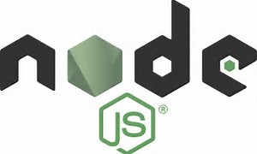
JavaScript
identical
similar
original
Notes:
In JavaScript we have found greater variety in the identical copies.
But we quickly realized that while these libraries are different, they are all various node.js packages.
It almost seemed as if our analysis of JavaScript only analyzed Node.js.
We did not expect such popularity of node.js so we investigated further, by looking at the actual file names and paths.

Slide 24
373860,30721,"build/gallery-debounce/gallery-debounce.js",12370
264560,28784,"node_modules/mocha/lib/browser/fs.js",875
373880,30721,"src/gallery-debounce/js/debounce.js",12372
264580,28784,"node_modules/mocha/browser/path.js",875
264600,28784,"node_modules/mocha/browser/progress.js",8298
373900,30721,"src/gallery-debounce/tests/unit/js/tests.js",12373
264680,28784,"node_modules/mocha/build/interfaces/bdd.js",8302
264700,28784,"node_modules/mocha/lib/interfaces/node_modules/exports.js",8303
373960,30721,"build/gallery-affix/gallery-affix-min.js",12376
264640,28784,"node_modules/mocha/lib/context.js",8300
264660,28784,"node_modules/mocha/lib/node_modules/foo/node_modules/hook.js",8301
373940,30721,"build/gallery-affix/gallery-affix-debug.js",12375
264720,28784,"node_modules/mocha/tests/interfaces/node_modules/index.js",8304
264520,28784,"node_modules/mocha/tests/browser/debug.js",8296
264460,28784,"lib/uri.js",8293
264540,28784,"node_modules/mocha/build/browser/events.js",8297
264620,28784,"node_modules/mocha/lib/browser/node_modules/tty.js",8299
264480,28784,"sanitizer.js",8294
264500,28784,"node_modules/mocha/index.js",8295
373920,30721,"build/gallery-affix/gallery-affix-coverage.js",12374
264740,28784,"tests/qunit.js",8305
264440,28784,"lib/html4.js",8292
264760,28784,"node_modules/mocha/lib/interfaces/tdd.js",8306
264420,26906,"js/script.js",8291
Notes:
And almost immediately, node_modules emerged as being the most frequently used path prefix.
-- talk about node.js and npm --
Regardless of the reason, it is important to know how many files are affected by this inclusion because in a sense we are not interested in these files in the same sense we have discarded forked repositories early on.

Slide 25
JavaScript Files over Time
251m
2008
2009
2010
2011
2012
2013
2014
2015
2016
Notes:
This graph shows the number of JavaScript files in all github repositories over the time.
JavaScript has been enjoying exponential growth amounting to 251 millions of files towards the end of 2016.
-- slide --
However, from this vast amount only 10.1 millions, a mere 4% are not copies.
So how much of the files was added by the inclusion of dependent packages?

Slide 26
JavaScript Files over Time
251m
2008
2009
2010
2011
2012
2013
2014
2015
2016
10.1m
Notes:
This graph shows the number of JavaScript files in all github repositories over the time.
JavaScript has been enjoying exponential growth amounting to 251 millions of files towards the end of 2016.
-- slide --
However, from this vast amount only 10.1 millions, a mere 4% are not copies.
So how much of the files was added by the inclusion of dependent packages?

Slide 27
JavaScript Files over Time
251m
2008
2009
2010
2011
2012
2013
2014
2015
2016
75m
30%
Notes:
When the npm files are filtered out, we end up with 75 million files, only 30% of the original dataset.
This large amount of files generated by a very small number of projects can be partially attributed to the fact that popular libraries often depend on other popular libraries, a trend observed in all four languages.

Slide 28
JavaScript
identical
similar
original
Notes:
With this knowledge, we can return to the analysis of code duplication for the JavaScript language.
But instead of the entire dataset, this time, we will only be looking at the files that were not added by the npm package manager displayed in the outer circle.
-- auto --
This filtering changes the ratio of original code, which has been increased to 11%.

Slide 29
JavaScript w/o node
identical
similar
original
( with node_modules)
Notes:
With this knowledge, we can return to the analysis of code duplication for the JavaScript language.
But instead of the entire dataset, this time, we will only be looking at the files that were not added by the npm package manager displayed in the outer circle.
-- auto --
This filtering changes the ratio of original code, which has been increased to 11%.

Slide 30
JavaScript w/o node
identical
similar
original
Reveal.js
Notes:
As with other languages, most copied files now come from a few popular libraries:
this time the selection is dominated by jQuery, which occupied more than a half of the observations
It has been followed from distance by Twitter Bootstrap, Angular.js, reveal.js, modernizr and several other libraries

Slide 31
identical
similar
original
1/20
intentional
4/20
unintentional
15/20
autogenerated
Reveal.js
Notes:
Closer look into the composition of the similar files reveals that:
only one out of 20 observations was classified as intentional copy & paste (same test with changed name)
20% were classified as unintentional
different versions of popular frameworks, namely jQuery, modernizr and angular.js
And 75% were autogenerated:
half of them angular.js configurations generated by Yeoman
express project files (express is a HTTP server for node.js)
grunt files (grunt is a task runner for node.js)
We now know that duplication at file level is prevalent across all four lanuages. The natural next step in our analysis was to see if any patterns emerge.

Slide 32
“fake data”
more developed
3%
4%
100
2%
5%
15%
# of Commits
10
6%
17%
36%
10
100
larger projects
# of Files
Notes:
Specifically we were interested to see whether projects of “higher quality” tend to have fewer duplication than the rest.
Our hypothesis is that the number of files the project has and the number of commits the project has received are good predictors of such quality.
The clone map graphs I am going to show therefore have the number of files on horizontal axis, and number of commits on vertical axis. Both axes are logarithmic.
We then aggregated projects into tiles and colored each tile according to aggregated percentage of identical copies We also report the percentages of copied files where readable.
-- talk fake data and expectations --

Slide 33
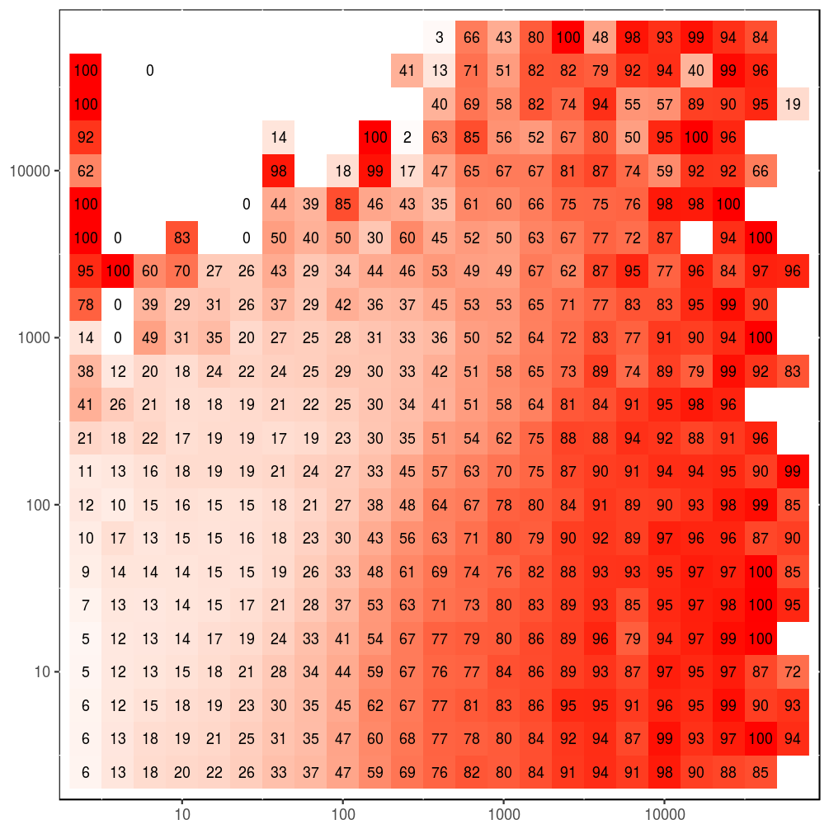
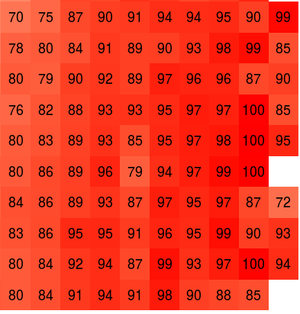
C/C++
10000
1000
# of Commits
100
10
10
100
1000
10000
# of Files
Notes:
The heatmaps of clone percentages are complemented with heatmaps of project density, which show how many projects were aggregated into a particular tile to help identify the outliers.
Our hypothesis is that only projects with very little commits will have elevated rates of copied files, this ratio generally decreasing with increased project sizes and commits.

Slide 34
!!
#?!!☹#$!?
C/C++
?
10000
1000
# of Commits
☺
100
☹ unfortunate
10
expected
10
100
1000
10000
# of Files
Notes:
The heatmaps of clone percentages are complemented with heatmaps of project density, which show how many projects were aggregated into a particular tile to help identify the outliers.
Our hypothesis is that only projects with very little commits will have elevated rates of copied files, this ratio generally decreasing with increased project sizes and commits.

Slide 35
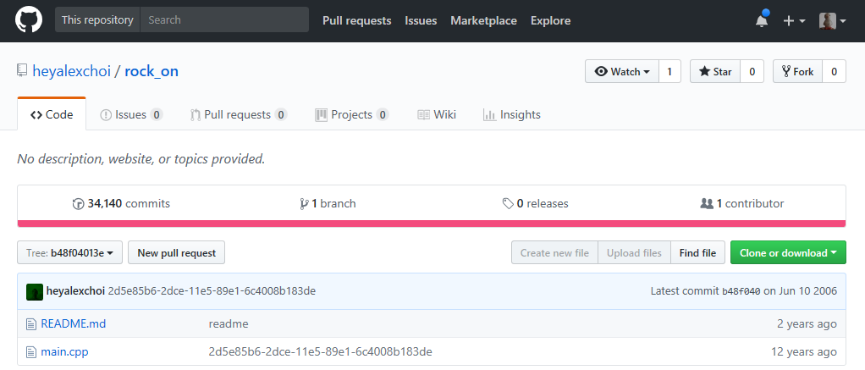
#?!!☹#$!?
Notes:
The heatmaps of clone percentages are complemented with heatmaps of project density, which show how many projects were aggregated into a particular tile to help identify the outliers.
Our hypothesis is that only projects with very little commits will have elevated rates of copied files, this ratio generally decreasing with increased project sizes and commits.

Slide 36
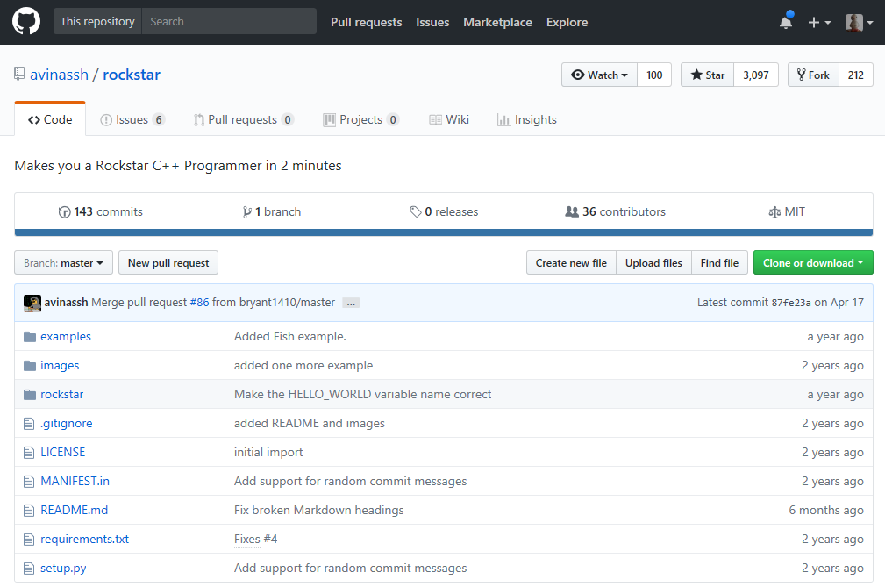

Slide 37
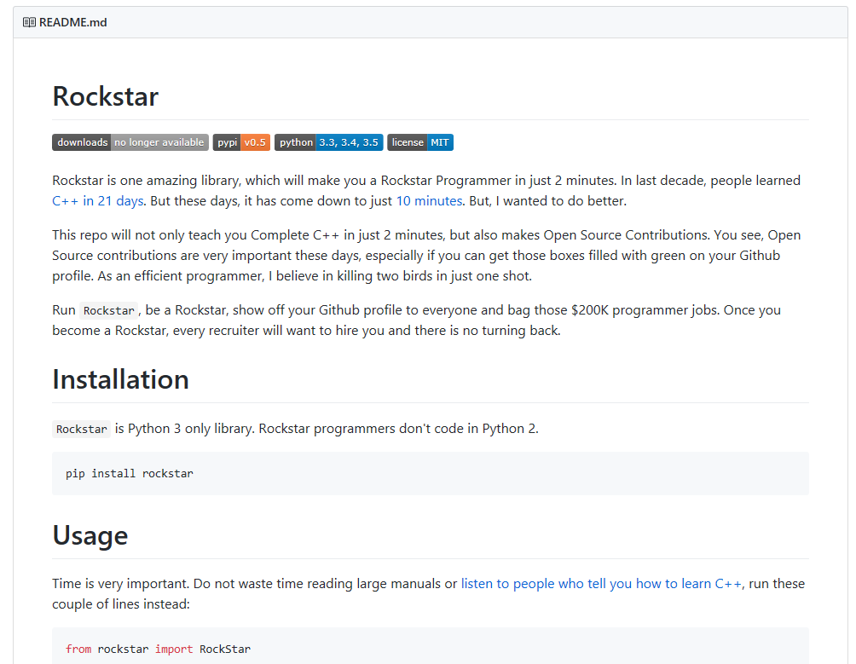
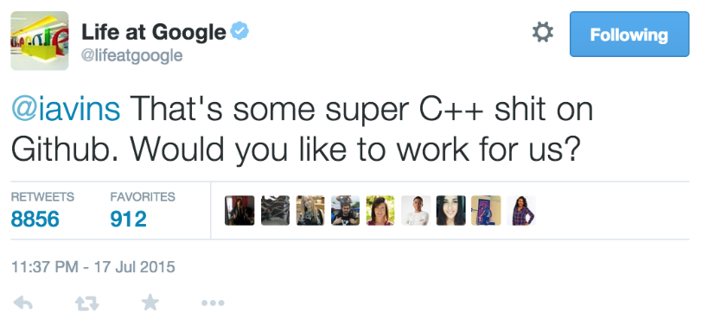
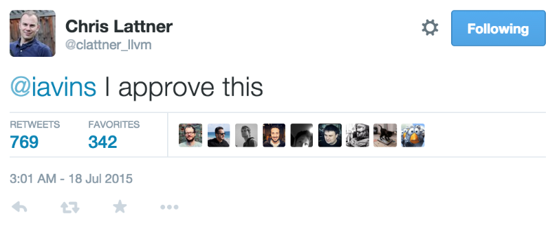
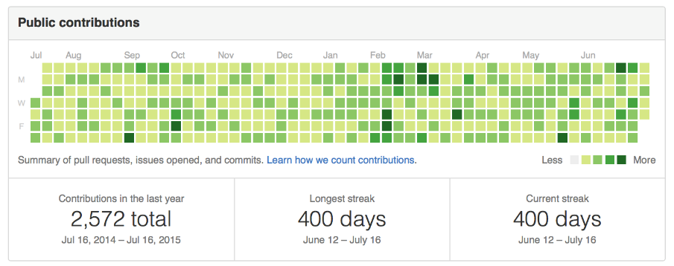

Slide 39
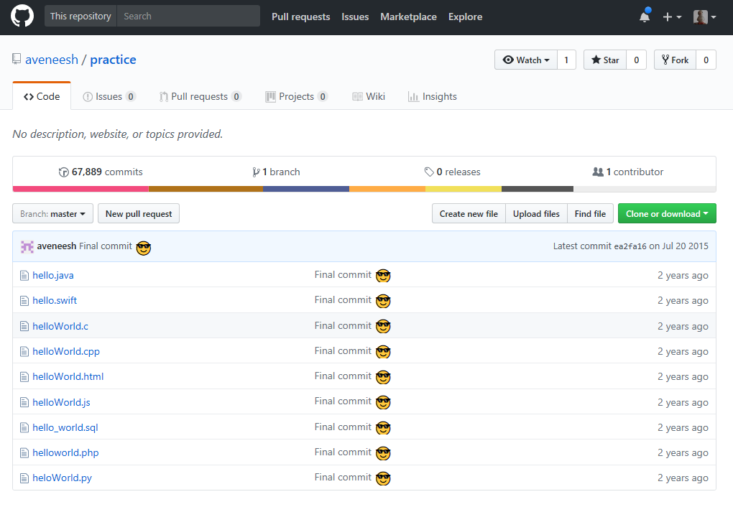
a

Slide 40
C/C++
?
10000
1000
# of Commits
☺
100
☹ unfortunate
10
expected
10
100
1000
10000
# of Files
Notes:
Let’s now look at the rest of the languages.

Slide 41
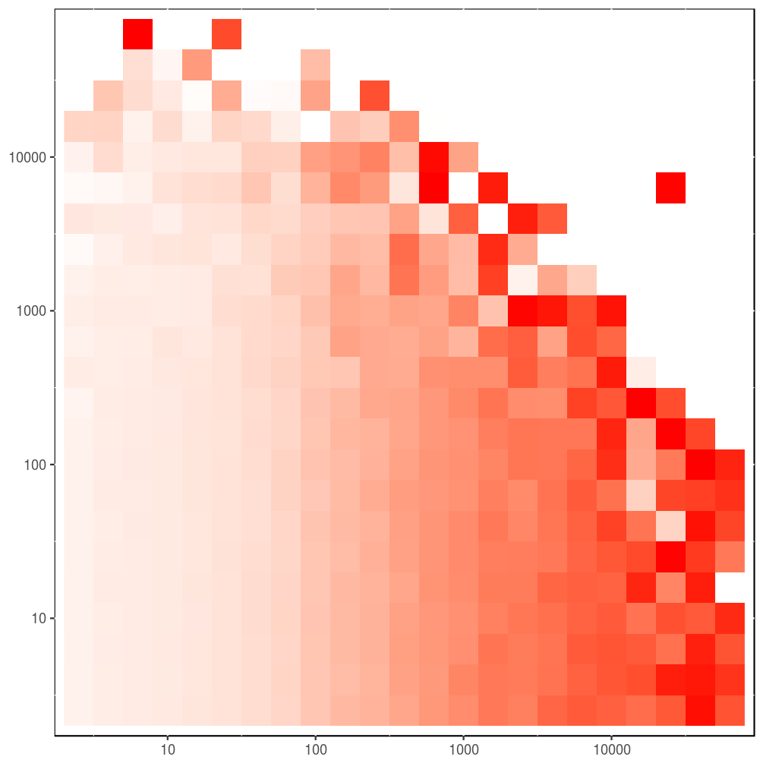
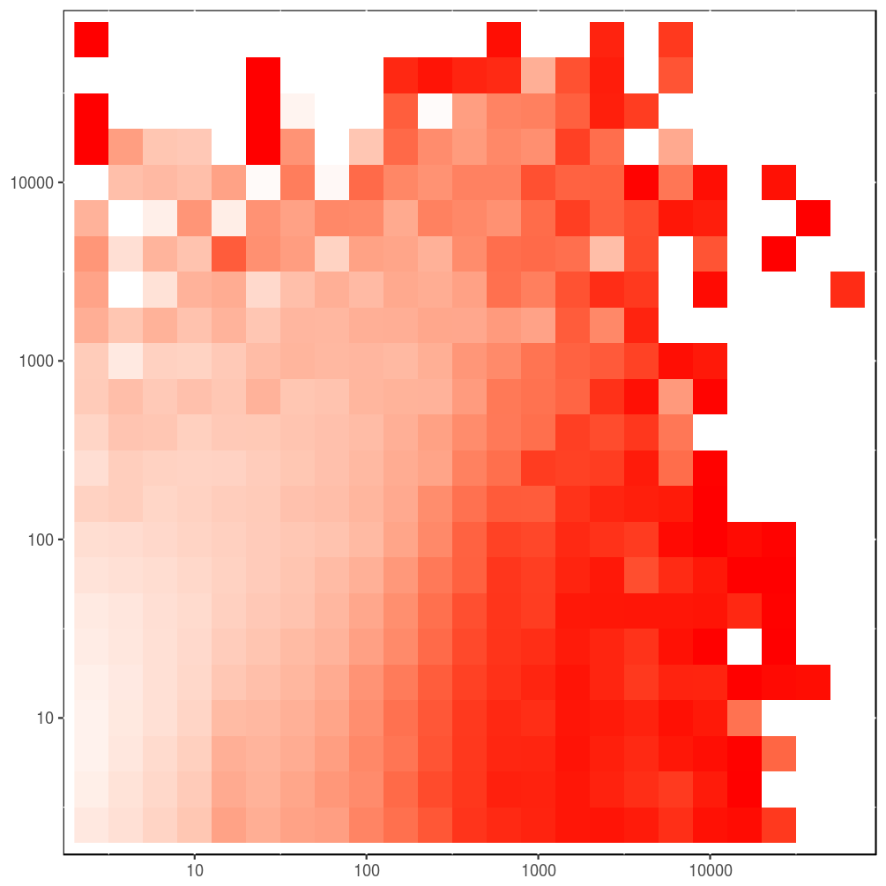
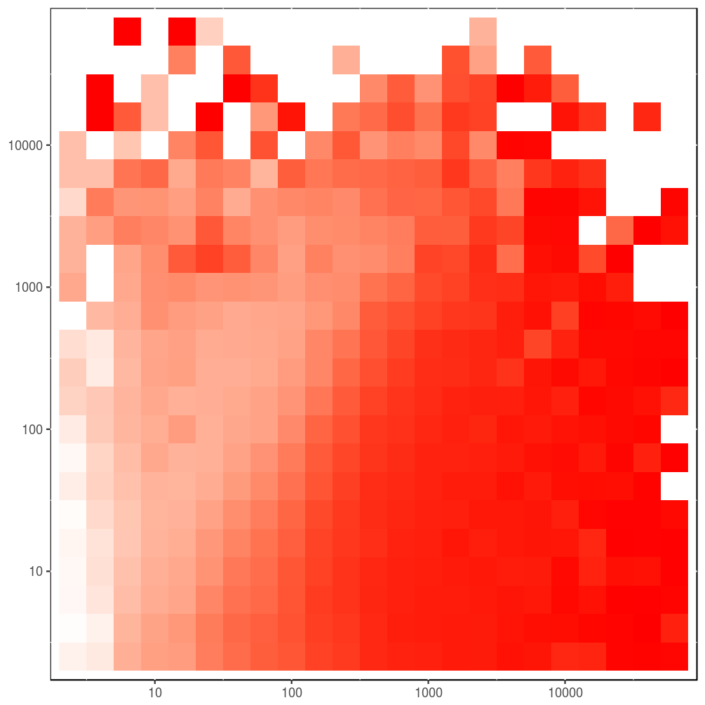
Java
C/C++
4
Python
JavaScript
Notes:
First observation we can make is that people want to be Rockstar programmers in C/C++ and Python, not as much in Java or JavaScript.
Java is also interesting because contrary to our hypothesis, the duplication seems to only depend on project sizes, not the number of commits.
And finally, JavaScript , as usually shows the highest percentage of copies (note that the clonemap already excludes the node_modules folder)

Slide 42
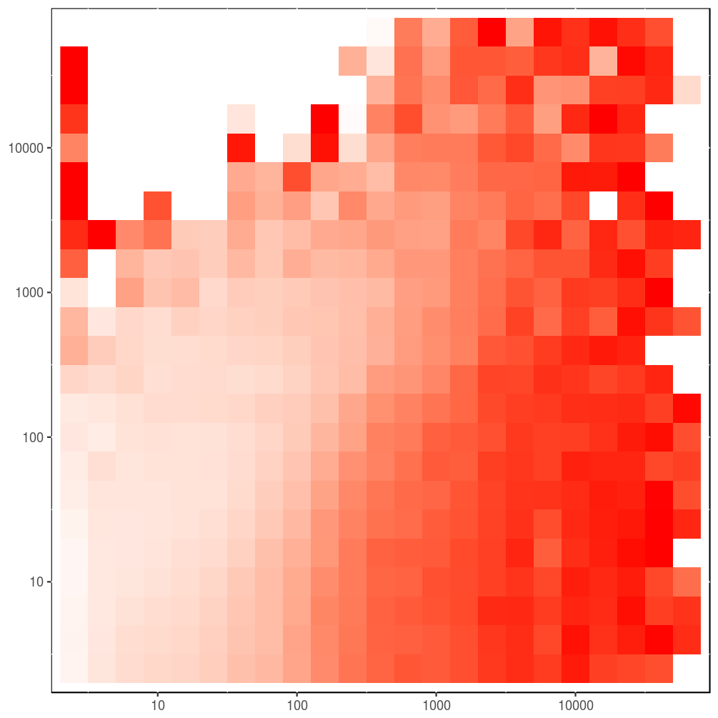
Java
C/C++
Python
JavaScript
Notes:
The heatmaps of clone percentages are complemented with heatmaps of project density, which show how many projects were aggregated into a particular tile to help identify the outliers.
Our hypothesis is that only projects with very little commits will have elevated rates of copied files, this ratio generally decreasing with increased project sizes and commits.

Slide 43
Thank you
There is more in the paper:
implementation
quantitative analysis (project level)
file- and token- hash distributions
project reapropriation
JavaScript and node.js ecosystem analysis
project website: http://mondego.ics.uci.edu/projects/dejavu
artifact: https://github.com/PRL-PRG/dejavu-artifact
web service: http://dejavu.ics.uci.edu
Notes:
TODO put here what else is in the paper that we did not talk about(don’t talk about them)

Slide 44
Single Project Inclusion
Notes:
Seeing this much cloning in files alone, we wanted to see how much entire projects are cloned
We have aggregated files into their projects and analyzed on a project level, what is the similarity in terms of files between two projects
The way to interpret these graphs is that, for example for JavaScript,

Slide 45
// This is a function
void foobar(int foo, int bar) {
int baz = foo + bar;
++baz;
if (baz > 42)
return foo;
else
return bar;
}
MD5: 7c3ab6d7a…
Notes:
Let’s look at a simple file, this one in C++.
First we take the its hash, which will allow us to determine if two files are identical very quickly.

Slide 46
// This is a function
void foobar(int foo, int bar) {
int baz = foo + bar;
++baz;
if (baz > 42)
return foo;
else
return bar;
}
Notes:
The file is then tokenized, removing any comments, whitespace, or operators.
For each file, the remaining tokens are then aggregated and form the basis of next step.

Slide 47
void foobar int foo int bar
int baz foo bar
baz
if baz 42
return foo
else
return bar
Notes:
The file is then tokenized, removing any comments, whitespace, or operators.
For each file, the remaining tokens are then aggregated and form the basis of next step.

Slide 48
void
foobar
int int int
foo foo foo
bar bar bar
baz baz baz
if
42
return return
else
Notes:
The file is then tokenized, removing any comments, whitespace, or operators.
For each file, the remaining tokens are then aggregated and form the basis of next step.

Slide 49
void : 1
foobar : 1
int : 3
foo : 3
bar : 3
baz : 3
if : 1
42 : 1
return : 2
else : 1
Notes:
The file is then tokenized, removing any comments, whitespace, or operators.
For each file, the remaining tokens are then aggregated and form the basis of next step.

Slide 50
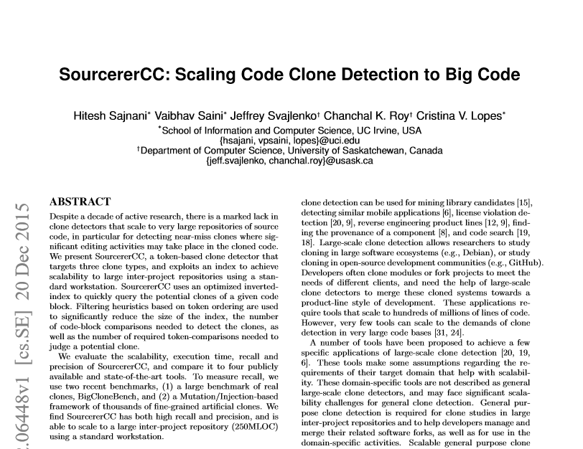
Detecting Similarity with SourcererCC
Notes:
SourcererCC is a tool for scalable clone detection analysis developed previously at UC Irvine.
The details about it can be found in the ICSE (aj-si-es-i) 2016 paper, but I will highlight the main features useful for our use.

Slide 51
Detecting Similarity with SourcererCC
near miss file clones
compare only what is needed
token based
bound the number of comparisons
tokens are indexed
data partitioned according to size
distributed
mondego.ics.uci.edu/projects/SourcererCC
Notes:
Sourcerer checks for near miss clones (80% similarity and more for the paper)
Compares tokenized files only (faster)
To limit the number of comparisons, tokens are indexed and files partitioned according to size so that we avoid comparisons that cannot find clones
The whole computation is distributed
With all this at our disposal, we have assumed that the centuries-long effort will be done in a few weeks tops.

